Slide 1
Supply Chain Analysis Report
Thalapathy

Slide 2
Atliq Mart is a growing FMCG manufacturer.
Currently Operating in 3 cities
Ahmedabad
Surat
Vadodara
Manufacturing Product categories includes
Diary
Food & Beverage
BACKGROUND

Slide 3
PROBLEM
Key customers do not renewed their Annual contract
REASON
Poor delivery service issue
SOLUTION
Developed a delivery service level tracking dashboard to track all customers that cover all key metrics, so that the management can respond customers issue swiftly.

Slide 4
PROBLEM
Key customers do not renewed their Annual contract
REASON
Poor delivery service issue
SOLUTION
Developed a delivery service level tracking dashboard to track all customers that cover all key metrics, so that the management can respond customers issue swiftly.

Slide 5
PROBLEM
Key customers do not renewed their Annual contract
REASON
Poor delivery service issue
SOLUTION
Developed a delivery service level tracking dashboard to track all customers that cover all key metrics, so that the management can respond customers issue swiftly.

Slide 6
Key Metrics
On-time delivery (OT)
In-full delivery (IF)
On Time in full (OTIF)
Volume Fill Rate(VOFR)
Line Fill Rate(LIFR)

Slide 7
Dashboard link -
https://www.novypro.com/project/supply-chain-2

Slide 8
Key Insights from data

Slide 9
Quantity Metrics
100%
13427k
Total Ordered quantity
12969k
Total Delivered quantity(96.59%)
458k
Total Undelivered quantity(3.41%)
3.4%

Slide 10
Overall Metric Goal
 | Current% | Target%
On Time delivery | 59.30% | 86.09%
In Full delivery | 52.78% | 76.51%
Ontime in full delivery | 28.02% | 65.91%

Slide 11
Overall Metric Goal
All KPI did not achieve their Target
 | Current% | Target%
On Time delivery | 59.30% | 86.09%
In Full delivery | 52.78% | 76.51%
Ontime in full delivery | 28.02% | 65.91%

Slide 12
Overall Metric Goal
All KPI did not achieve their Target
 | Current% | Target% | lag%
On Time delivery | 59.30% | 86.09% | 26.79%
In Full delivery | 52.78% | 76.51% | 23.73%
Ontime in full delivery | 28.02% | 65.91% | 37.89%
There is big gap between OTIF & its targets

Slide 13
Conclusion
Why did the customer do not renewed their Annual contract ?
The above visuals clearly shows that the products were
Not delivered on time
Not delivered in full quantity
which could have resulted in bad customer service.

Slide 14
Metric
VOFR VS LIFR
 | Current%
Volume Fill Rate | 96.59%
Line Fill Rate | 65.96%

Slide 15
Metric
VOFR VS LIFR
 | Current%
Volume Fill Rate | 96.59%
Line Fill Rate | 65.96%
LIFR is very low compared to VOFR

Slide 16
Conclusion
How many quantity shipped out of the total quantity ordered ?
96.59%(VOFR)
How many lines shipped out of the total lines ordered ?
65.96%(LIFR)

Slide 17
Customer Insights

Slide 18
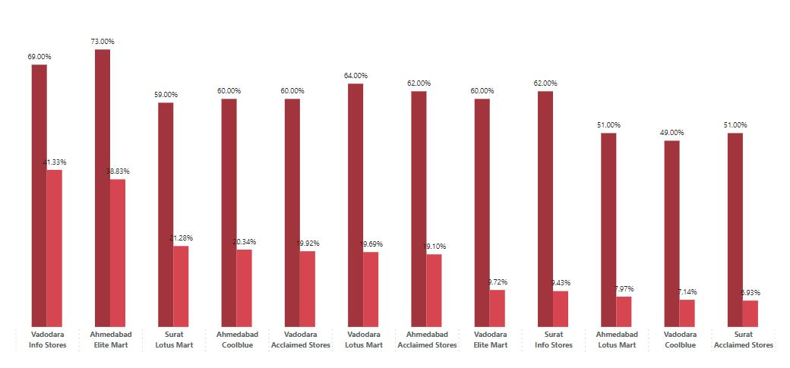
Top customer to focus
Lotus Mart in all city
Coolblue in Vadodara
Acclaimed stores in Surat, Vadodara
Info Stores in Surat
Elite Mart in Vadodara

Slide 19
More focus given to Lotus Mart in Ahmedabad because of poor delivery service in all three key metrics OT, IF, OTIF

Slide 20
Product Insights

Slide 21
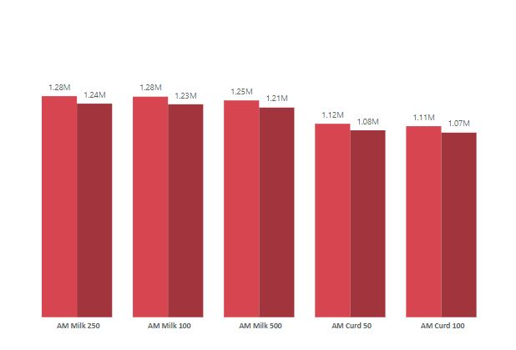
This visual clearly shows that
More demand for diary products
So the production team should increase the production quantity to meet the customer requirement.

Slide 22
This visual clearly shows that
More demand for diary products
So the production team should increase the production quantity to meet the customer requirement.
Diary products
AM Milk
AM Curd
AM Butter

Slide 23
Thank you

